Slide 1

EEG Signal Classification using transfer learning
Mohammad Mahdi Mirrashid
Dr. Shamsollahi
mohammadmahdi.mirrashid@ee.sharif.edu
EE Department – Sharif University of Technology

Slide 2
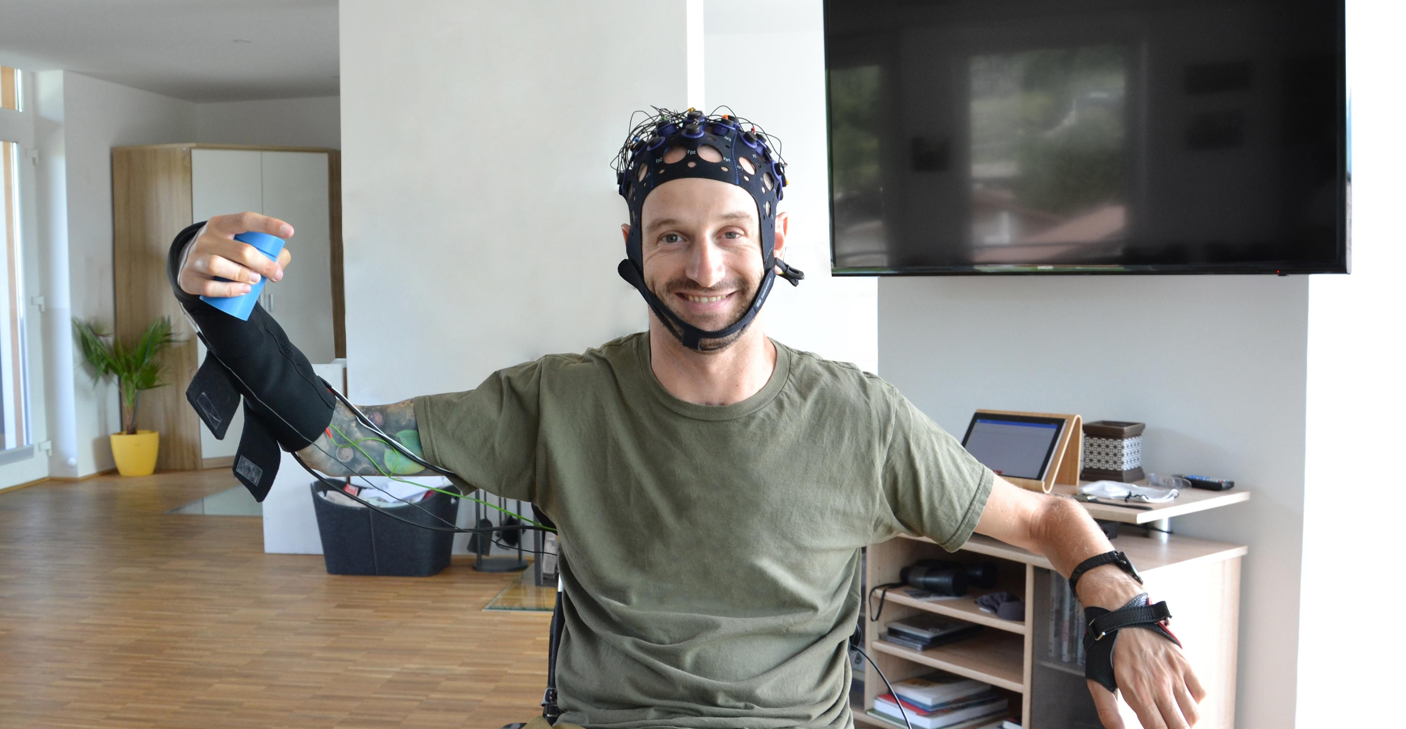
INtroduction

Slide 3
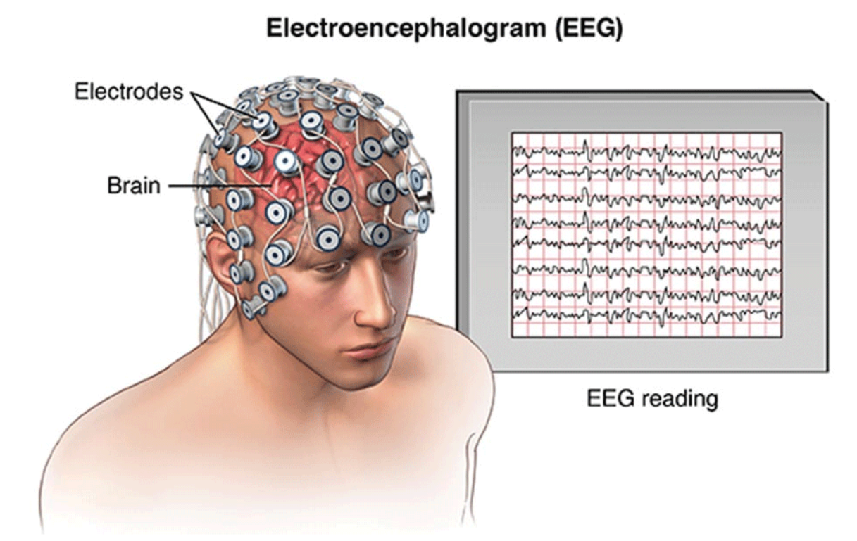
Introduction: motivation
EEG signal classification
Challenges
Cross subject/session variance
Noise
Large calibration effort

Slide 4
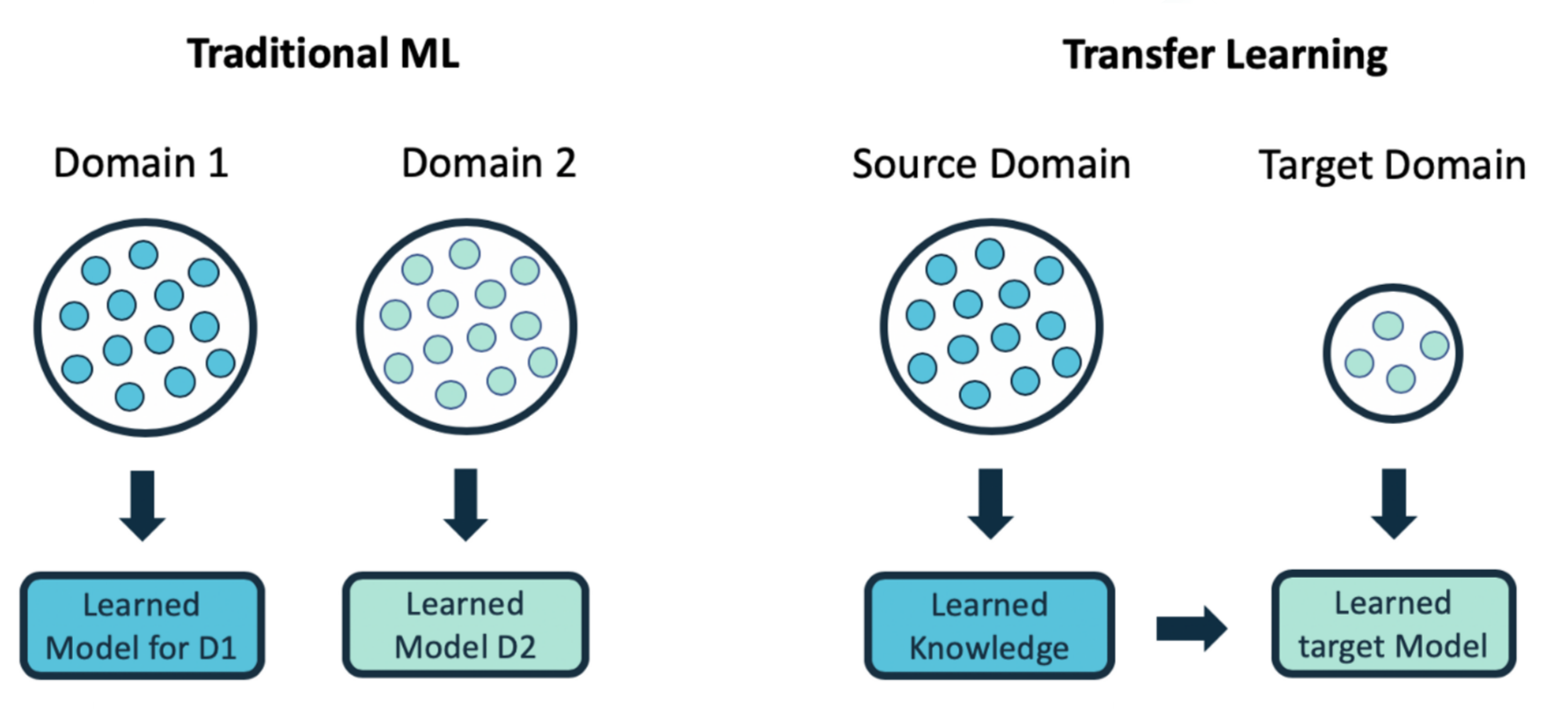
Introduction: transfer learning definition
Problem definition (domain and task)
Knowledge transfer (source to target)

Slide 5
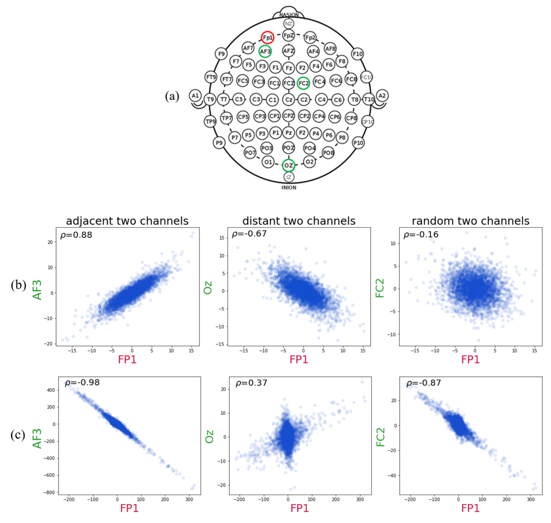
Introduction: transfer learning approach
Advantages
Works with limited or no labeled target data
Efficiency through model reuse
Applicable to complex models with challenging computations and limited data
EEG signal variation (domain)

Slide 6
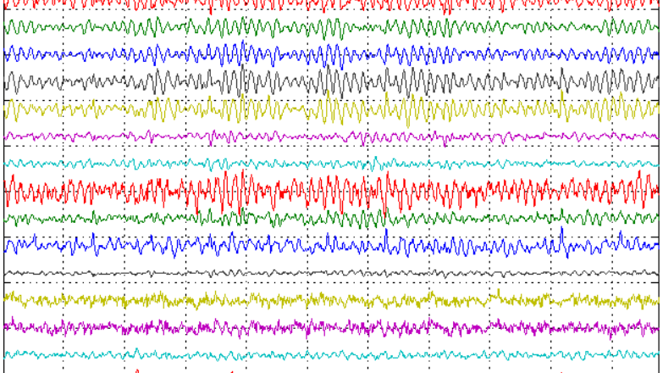
Literature Review: Ea, Gaussian processes, Adaptive tl

Slide 7
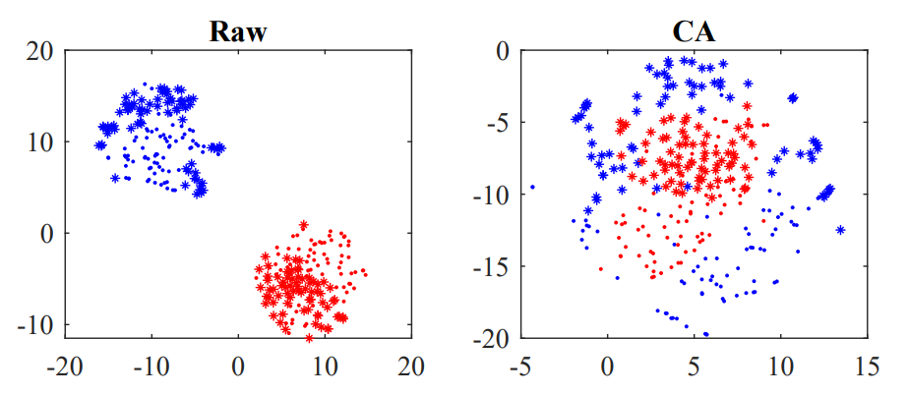
Euclidean Alignment: introduction
Idea: make data from different subjects more similar
EEG covariance matrices are SPD and directly encode spatial information
ERP mean augmentation for temporal information encoding
Covariance matrices can directly be classified (RA-MDRM)

Slide 8
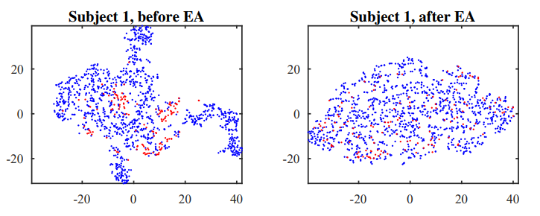
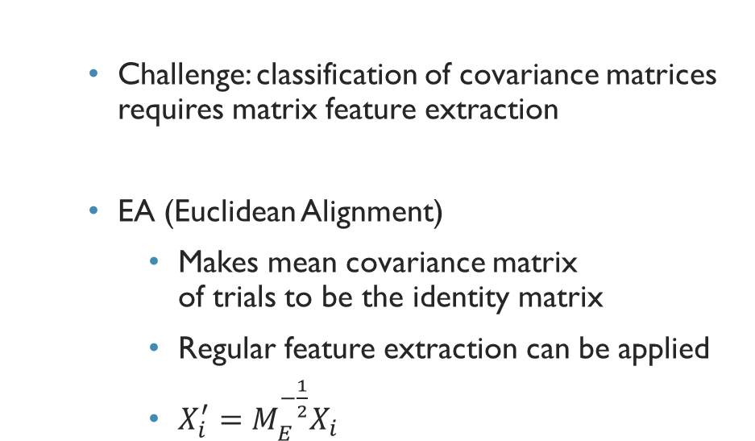
Euclidean Alignment: introduction 2
Challenge: classification of covariance matrices requires matrix feature extraction
EA (Euclidean Alignment)
Makes mean covariance matrix of trials to be the identity matrix
Regular feature extraction can be applied
$X_{i}^{′}=M_{E}^{−\frac{1}{2}}X_{i}$

Slide 9
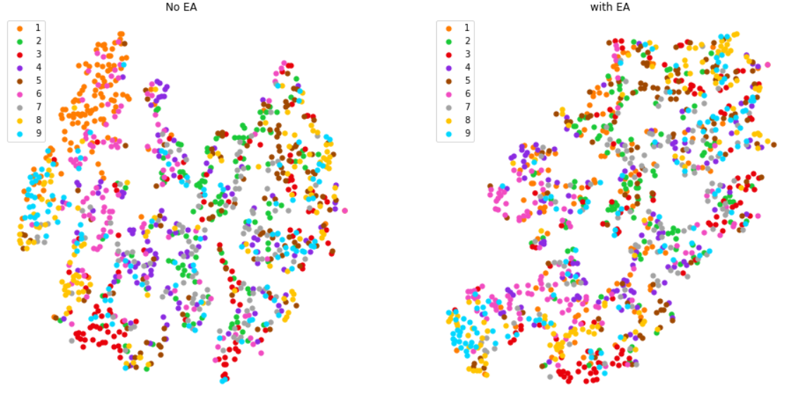
Euclidean Alignment: Results
BCIIV/2a dataset
9 subjects, 2 class motor imagery
EA+CSP feature extraction
SVM classifier
82.5% EA accuracy vs. 71.5% baseline accuracy

Slide 10
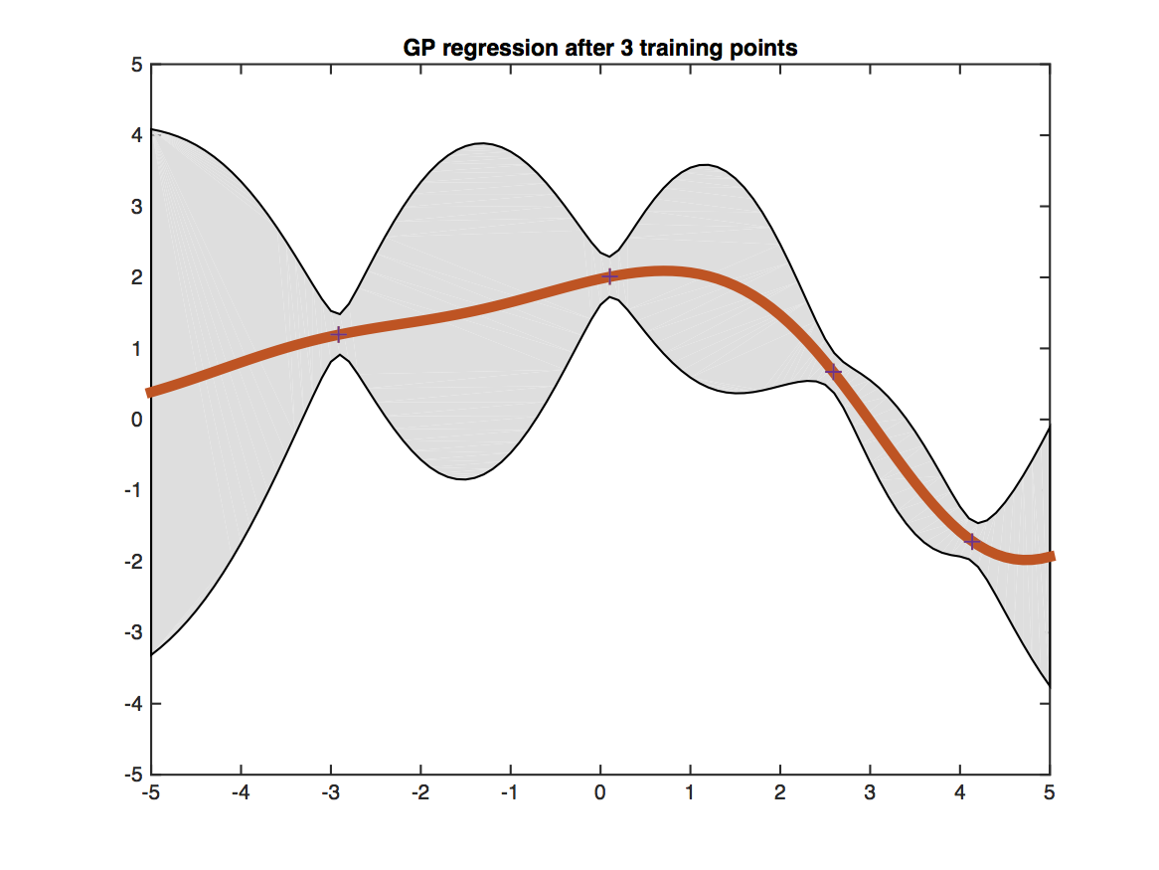
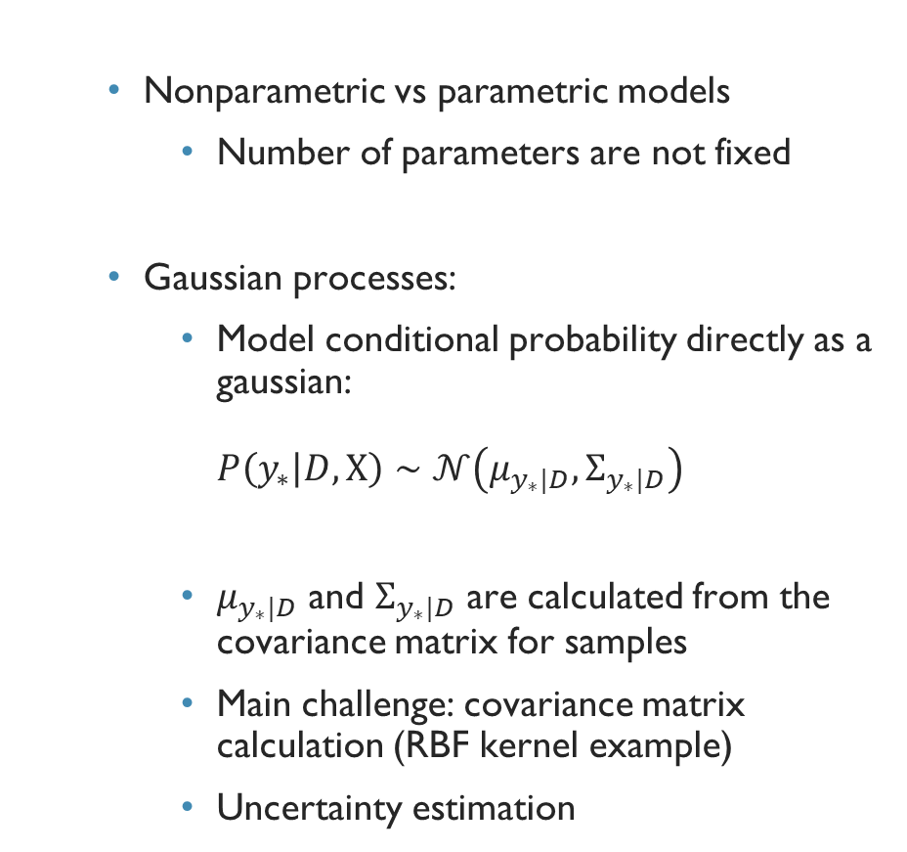
Gaussian processes: introduction
Nonparametric vs parametric models
Number of parameters are not fixed
Gaussian processes:
Model conditional probability directly as a gaussian: $P\left(y_{∗} | D, Χ\right)∼𝒩\left(μ_{y_{∗}|D},Σ_{y_{∗}|D}\right)$
$μ_{y_{∗}|D}$ and $Σ_{y_{∗}|D}$ are calculated from the covariance matrix for samples
Main challenge: covariance matrix calculation (RBF kernel example)
Uncertainty estimation

Slide 11
Gaussian processes classification: results
BCIIV/2a dataset
9 subjects, 2 class motor imagery
CSP feature extraction
75% accuracy vs. 71.5 for SVM
80.5% accuracy with EA applied

Slide 12
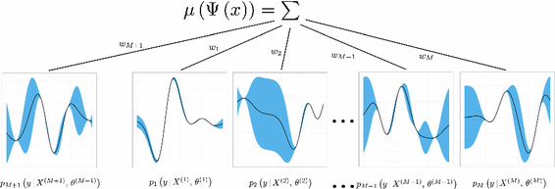
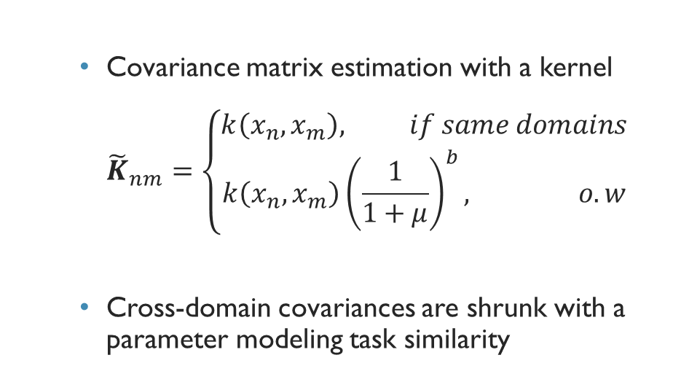
Adaptive transfer learning: introduction
Covariance matrix estimation with a kernel ${\tilde{K}}_{nm}=\left\{\begin{aligned}k\left(x_{n}, x_{m}\right), if same domains \\ k\left(x_{n},x_{m}\right){\left(\frac{1}{1+μ}\right)}^{b}, o.w\end{aligned}\right.$
Cross-domain covariances are shrunk with a parameter modeling task similarity

Slide 13
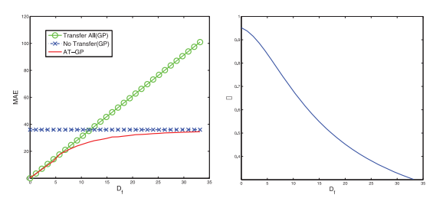
Adaptive transfer learning: results
WiFi Localization Dataset
5% of data in the target task are used for training
Significant improvement compared with no transfer

Slide 14
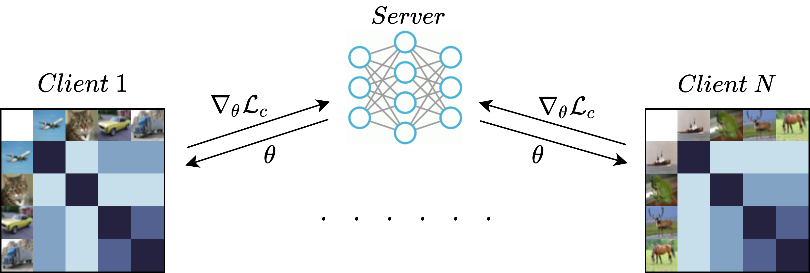
GOALS AND CHALLENGES
Goals
Transfer GP applied to EEG
Federated GP applied to EEG
Combination
Challenges
Representation of EEG
Transfer approach

Slide 15
references
Weiss, Karl, Taghi M. Khoshgoftaar, and DingDing Wang. “A Survey of Transfer Learning.” Journal of Big Data 3, no. 1 (2016). https://doi.org/10.1186/s40537-016-0043-6.
EEG Applications (neurotechedu.com)
Pan, S. J., & Yang, Q. (2010). A Survey on Transfer Learning. IEEE Transactions on Knowledge and Data Engineering, 22(10), 1345–1359. doi:10.1109/tkde.2009.191
Wan, Zitong, Rui Yang, Mengjie Huang, Nianyin Zeng, and Xiaohui Liu. “A Review on Transfer Learning in EEG Signal Analysis.” Neurocomputing 421 (2021): 1–14. https://doi.org/10.1016/j.neucom.2020.09.017.
Wu, Dongrui, Yifan Xu, and Bao-Liang Lu. “Transfer Learning for EEG-Based Brain–Computer Interfaces: A Review of Progress Made since 2016.” IEEE Transactions on Cognitive and Developmental Systems 14, no. 1 (2022): 4–19. https://doi.org/10.1109/tcds.2020.3007453.
Zhang, W., & Wu, D. (2019). Manifold Embedded Knowledge Transfer for Brain-Computer Interfaces. arXiv. https://doi.org/10.48550/arXiv.1910.05878
P. Zanini, M. Congedo, C. Jutten, S. Said, and Y. Berthoumieu, “Transfer learning: a Riemannian geometry framework with applications to brain-computer interfaces,” IEEE Trans. on Biomedical Engineering, vol. 65, no. 5, pp. 1107–1116, 2018.
H. He and D. Wu, “Transfer learning for brain-computer interfaces: A Euclidean space data alignment approach,” IEEE Trans. on Biomedical Engineering, vol. 67, no. 2, pp. 399–410, 2020.
ElMoaqet, H. et al. (2022) “A deep transfer learning framework for Sleep Stage classification with single-channel EEG Signals,” Sensors, 22(22), p. 8826. Available at: https://doi.org/10.3390/s22228826.
Ju, C., Gao, D., Mane, R., Tan, B., Liu, Y., & Guan, C. (2020). Federated Transfer Learning for EEG Signal Classification. arXiv. https://doi.org/10.1109/EMBC44109.2020.9175344
Zhong, P., Wang, D., & Miao, C. (2019). EEG-Based Emotion Recognition Using Regularized Graph Neural Networks. arXiv. https://doi.org/10.48550/arXiv.1907.07835

